Slide 1
4. Robot Force Control
4.1 The 1-DOF Force Control
4.2 The n-DOF Force Control
4.3 Impedance Control
4.4 Constrained Motion Control
- 1 -

Slide 2
4.2 The n-DOF Force Control
Jacobian and environmental forces
Before generalizing to an n-link robot case, let us define some notation because the forces acting on the environment are expressed in the task space (constraint frame) coordinates, but the robot equation is usually expressed in the joint space coordinates.
The task space coordinates are related to the joint space coordinates via a Jacobian matrix called Task Space Jacobian matrix.
- 2 -

Slide 3
4.2 The n-DOF Force Control
Force Control of an n-DOF Manipulator
The relationship between the task space vector and the joint space vector can be found from the manipulator kinematics and the appropriate task space geometry and is expressed by a function given by:
The derivation of x is given by
- 3 -

Slide 4
4.2 The n-DOF Force Control
where, in general,
is the task space Jacobian matrix. The transformation matrix T is typically used when converting joint velocities to the derivatives of the roll, pitch, and yaw associated with the end-effector orientation(i.e. the angular velocities).
- 4 -

Slide 5
4.2 The n-DOF Force Control
Consider the robot dynamic equation when the robot is in contact with its environment
where force exerted by the robot on the environment in joint space coordinates.
If the robot is not moving, the robot equation becomes
which means that the joint torque of the robot has two parts: one to maintain the robot position against gravity, and the other to exert a force on the environment (assuming no static friction).
(4.2.1)
- 5 -

Slide 6
4.2 The n-DOF Force Control
The force on the environment is usually expressed in the task space coordinates .
Using conservation of energy and , we have
Therefore, the relationship between the joint space and the task space force is given by
The robot equation which includes the environmental force can now be expressed as
- 6 -

Slide 7
4.2 The n-DOF Force Control
The force exerted on the environment is now expressed in matrix form
where is a diagonal, positive semi-definite, constant matrix denoting the environmental stiffness
and is a vector denoting the static location of the environment.
Note that if the robot is not constrained in a particular task space direction, the corresponding diagonal element of is set to zero.
- 7 -

Slide 8
4.2 The n-DOF Force Control
The PD stiffness controller for the n-link robot is given by
where e =
and denotes the desired constant end-effector position.
Note that term is necessary to transform the task space error signal into joint space.
- 8 -

Slide 9
4.2 The n-DOF Force Control
Substituting the PD control law into the dynamics (4.2.1) gives the closed-loop dynamics
where
To show stability, a Lyapunov stability analysis can be carried out on the closed-loop system.
In the steady state, the position of the robot is given by
As in the single degree of freedom case, we assume that is much lager than .
- 9 -

Slide 10
4.2 The n-DOF Force Control
In the constrained task space direction, the steady state force on the environment can be approximated by
which means that can be interpreted as specifying the stiffness of the manipulator in the task space direction .
In the nonconstrained task space direction, ,
therefore
which means that we obtain set-point control.
- 10 -

Slide 11
4.2 The n-DOF Force Control
Therefore, this PD stiffness control law achieve set-point position control as well as steady state force control. The control gains are used to adjust stiffness of the manipulator.
Disadvantage of stiffness control is that it can only be used for set-point control, the desired position and the desired force must be constant.
In many force control applications, while the desired force may be constant, the position trajectory is not.
- 11 -

Slide 12
4.2 The n-DOF Force Control
Hybrid Position/Force Control Scheme
A Cartesian Robot Aligned with Constraint Frame {C}
Constraint frame {C} is a frame attached either to the environment or to the end effector of the robot so that the task can be described in it.
For the simple robot having three degrees of freedom with prismatic joints acting in X,Y and Z directions, the robot is assumed to be lined up with the constraint frame {C} which is attached to the environment.
- 12 -

Slide 13
4.2 The n-DOF Force Control
The end-effector is in contact with a surface of stiffness with its force in the direction of .
Therefore, force control is required in direction , and position control in the and directions.
In this case, the solution to the hybrid position and force control problem is clear.
- 13 -

Slide 14
4.2 The n-DOF Force Control
Joints 1 and 3 can be controlled for positioning while joint 2 should be controlled using a force controller.
We could then supply a position trajectory in and directions while independently supply a force trajectory (perhaps just a constant) in the direction.
- 14 -

Slide 15
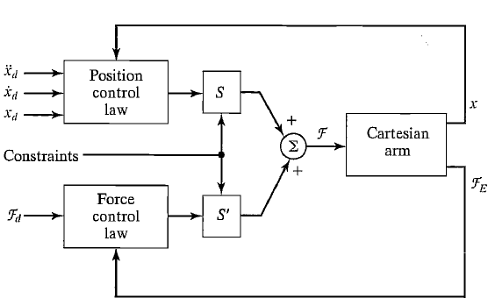
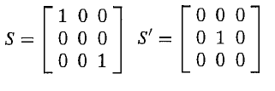
4.2 The n-DOF Force Control
The hybrid controller for a 3-DOF Cartesian arm.
- 15 -

